Slide 1
Loop Transformation

Slide 2
Representing Nested Loops
M-level nested loop:
L₁: DO i₁ = p₁, q₁
L₂: DO i₂= p₂, q₂
 
L_{m}: DO i_{m} = p_{m}, q_{m}
H(i₁, i₂, ☹, i_{m})
Enddo

Enddo
Enddo
The loop indices {i_{k}; 1 ≤ k ≤ m} form an m × 1 index vector
i = [i₁, i₂, ☹, i_{m}]^{T}
which corresponds to a lattice point in the m-dimensional index space I
Loop bounds: {p_{k}, q_{k}}.
Loop body: H(i₁, i₂, ☹, i_{m}) that is to be executed in a single processor in a single time unit (t.u.). The granularity considered here is a loop body.

Slide 3
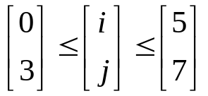
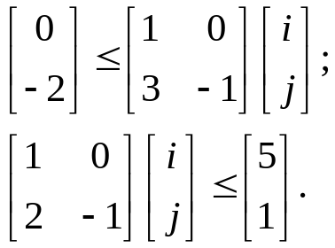
Regular Nested Loops
If the loop bounds are all constants, the index points of this nested loop form a rectangular parallelepiped in the index space: {i; p ≤ i ≤ q}
(General situation) the loop bounds are linear (affined) function with integer coefficients of outer loop indices and can be formulated as two inequalities:
p₀ ≤ P i and Q i ≤ q₀
P, Q: lower triangular matrices
If P = Q, it is a regular nested loop.
Examples:
Do i = 0, 5
Do j = 3, 7
a(i,j)=b(i)+c(j)
Enddo
Endod
Do i = 0, 5
Do j = 2*i-1, 3*i+2
a(i,j)=b(i)+c(j)
Enddo
Enddo

Slide 4
Schedule and Precedence
A schedule S: i → t(i) is a mapping from each index point i in the index space I to a positive integer t(i) which dictates when this iteration is to be executed.
An iteration H(i) will be executed before H(j) if its index vector i lexicographically precedes index vector j. That is, i  j.
This implies there exists an integer r, 1 ≤ r ≤ m, such that i_{k} = j_{k} for k < r, and i_{r} < j_{r}.
Example [1 3 4]  [2 1 1]
If two iterations have no (inter-iteration) dependence between them, then these two iterations can be executed concurrently.

Slide 5
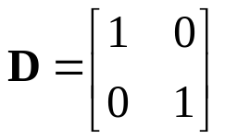
Inter-iteration Dependence
An iteration H(j) is dependent on iteration H(i) if
  i  j; and
  H(j) will read from a memory location (including registers) whose value is last written during execution of iteration H(i).
The corresponding dependence vector d is defined as:
d = j - i  0
A matrix D consisting of all dependence vectors of an algorithm is called a dependence matrix.
Observation
If H(j) is dependent on H(i), then t(i) < t(j).
The dependence relation imposes a partial ordering on the execution of the iterative loop nest.
Example
Do i=1,4
Do j=1,4
a(i,j)=a(i-1,j)+a(i,j-1)
Enddo
Enddo

Slide 6
Data Dependence (General)
True (Data) Dependence
S1: A:= B + C
S2: D:= A + 2
S3: E:= A + 3
S2 and S3 depend on S1
Anti-dependence
S1: A:= B + C
S2: B:= D + 2
S2 depends on S1 because the same variable B is assigned to new values during execution more than once.
Output Dependence
S1: A:= B + C
S2: D:= A + 2
S3: A:= E + 3
S3 depends on S1 because the same variable A is assigned to new values in both statements.
Both Anti-dependence and output dependence can be removed using single-assignment transform to ensure each variable is assigned to new values only once during the execution of the algorithm

Slide 7
Single Assignment Transformation
Consider the code segment:
S1: A:= B + C
S2: B:= D + 2
  Variable B is assigned with new values in addition to its initially assigned value. Thus, it causes anti-dependence.
Solution: variable renaming
S1: A:= B + C
S2: B1:= D + 2
  By introducing a new variable B1, S1 and S2 can be executed in parallel.
When an algorithm is represented in single assignment form, false dependence (anti- and output dependence) are removed at the expense of additional storage requirement.
No specific algorithm available to perform single assignment transform automatically yet.

Slide 8
Single Assignment Transform
Methods for transforming an algorithm into single assignment format:
  For scalars: introduce new variables (renaming)
  For arrays: introducing additional array indices
Example (array)
Do j=1,N
C(i)=C(i)+A(j)*B(j)
Do j=1,N
C(i,j)=C(i,j-1)+A(j)*B(j)
Another Example
Do i=1,N
A(i)=B(i)+C(i)
D(i)=A(i)+A(i+1)
Enddo
  Note that there is an anti-dependence in the loop body. Introduce a new array A1
Do i=1,N
A1(i)=B(i)+C(i)
D(i)=A1(i)+A(i+1)
Enddo
  Then problem is solved.

Slide 9
Variable Localization by Duplication
In a parallel, distributed processing system, a variable used by more than one iterations may need to be broadcast to multiple processors physically.
In the loop body of a nested loop algorithm, inter-iteration data broadcasting is needed when an indexed variable has lower dimensions (fewer index vector dimensions) then other variables.
Example:
c(i,j)=c(i,j-1)+a(i,j)*b(j)
b(j) will be used by each i-iterations.
Solution:
  Rename the variable to a new indexed variable with the same index dimensions as other variables. Then use variable duplication through the newly added index.
b1(0,j)=b(j)
b1(i,j)=b1(i-1,j)
C(i,j)=c(i,j-1)+a(i,j)*b1(i,j)

Slide 10
Algorithm Rewrite Example
Matrix-vector product:
c = A b
do i=1,m
c(i)=0
do j=1,n
c(i)=c(i)+a(i,j)*b(j)
enddo
enddo
Need:
  Single assignment transform
  Index localization
Transformed formulation
  Loop is replaced by the Doall statement
c1(i,0)=0; 1≤i≤m
b1(0,j)=b(j); 1≤j≤n
b1(i,j)=b1(i-1,j); 1≤i≤m; 1≤j≤n
c1(i,j)=c1(i,j-1)+a(i,j)*b1(i,j)
1≤i≤m; 1≤j≤n
c(i)=c1(i,m); 1≤i≤m

Slide 11
Data (Iteration) Dependence Graph
j
c1(i,0)=0; 1≤i≤m
b1(0,j)=b(j); 1≤i≤m
b1(i,j)=b1(i-1,j); 1≤j≤n
c1(i,j)=c1(i,j-1)+a(i,j)*b1(i,j)
1≤i≤m; 1≤j≤n
c(i)=c1(i,m); 1≤j≤n
c(1)
c(2)
c(3)
c(4)
b(3)
b(2)
b(1)
i
c1(i,j)
Induced dependence due to
distribution of duplicated data. Its direction is flexible!
b1(i-1,j)
b1(i,j)
c1(i,j-1)
In an iteration space data (loop) dependence graph, no delay nor loops allowed.
Data dependence
Granularity = Loop body

Slide 12
Shift-Invariant Iteration DG
If the dependence structure of each node in the iteration DG remains the same, it is called a shift-invariant DG.
In a SIDG, the entire DG can be generated by shifting a single copy of the node dependence structure to every node inside the iteration bounds.
Conditional statements are not allowed.
An algorithm formulation that leads to a shift-invariant DG is called a regular iterative algorithm (RIA).
An RIA algorithm is a single regular nested loop such that their loop index vector i satisfies
p ≤ Mi ≤ q
where p, q are constant vectors, and M is a lower triangular matrix.

Slide 13
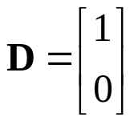
Parallel Execution by Vectorization (DoAll)
If the last row of the dependence matrix contains all zero entries, the innermost loop can be replaced by a Doall loop to have all iterations executed concurrently.
Refer to the example to the right. The inner loop (index j) can be executed simultaneously as there are no dependence between operations of different values of j.
Example:
Do i=1,4
Do j=1,4
a(i,j)=a(i-1,j)+b(i,j)
Enddo
Enddo
Do i=1,4
Doall j=1,2,3,4
a(i,j)=a(i-1,j)+b(i,j)
Enddoall
Enddo

Slide 14
DG Analysis
a(i,j)=a(i-1,j)+b(i,j)
1 ≤ i ≤ 4, 1 ≤ j ≤ 4,
Sequential execution schedule
Vectorized execution schedule
j
j
i
i

Slide 15
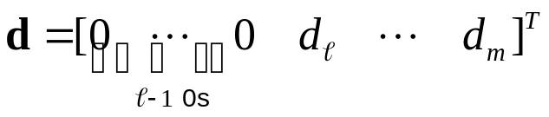
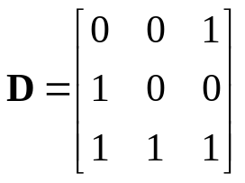
Levels of Dependence Vectors
For a dependence vector
d ≠ 0. Its level = , and Loop L carries the dependence.
Example,
Do i=0,3
Do j=0,3
Do k=0,3
a(i,j,k)=a(i,j-1,k-1)+1;
b(i,j,k)=2*b(i,j,k-1)-1;
c(i,j,k)=c(i-1,j,k-1)-1;
Enddo
Enddo
Enddo
The levels of its dependence matrix is 2, 3, 1. All 3 loops carries dependence.
k
j
i

Slide 16
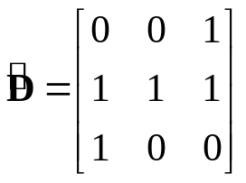
Loop Interchange
Inter-change L₂ and L₃:
Do i=0,3
Do k=0,3
Do j=0,3
A(i,k,j)=A(i,k-1,j-1)+1;
B(i,k,j)=2*B(i,k-1,j)-1;
C(i,k,j)=C(i-1,k-1,j)-1;
Enddo
Enddo
Enddo
where A(i,k,j) = a(i,j,k), B(i,k,j) = b(i,j,k), and C(i,k,j) = c(i,j,k)
New dependence matrix
New levels = 2,2,1
J-loop can be executed in parallel when i and k are fixed.
To verify: Let i = k = 0,
A(0,0,j)=A(0,-1,j-1)+1
B(0,0,j)=2*B(0,-1,j)-1
C(0,0,j)=C(-1,-1,j)-1
all these operations can be executed for different values of j simultaneously!
k
j

Slide 17
Exploitation of Parallelism
Inner Loop Parallelism
  If the first non-zero element in each dependence vector is above loop level k, then all inner loop nests, starting from level k can be executed in parallel.
Outer Loop Parallelism
  To execute an outer loop in parallel (where each inner loop nest is executed sequentially), the corresponding dependence matrix must have at least a row containing only zero entries.

Slide 18
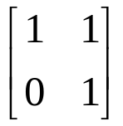
Uni-Modular Loop Transformation
A square matrix U is uni-modular if
  It contains integer entries
  Det(U) = 1
Examples:
Uni-modular index transform:
i  U i = k
shift and rotate index vectors
If used properly, a uni-modular transformation enables more loops to be executed in parallel.
A loop transformation matrix U is valid if for each d in D,
Ud  0.
The dependence matrix of the transformed loop is UD.

Slide 19
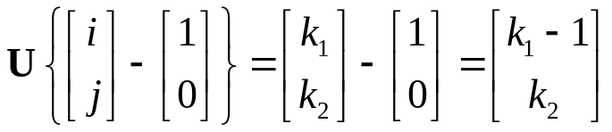
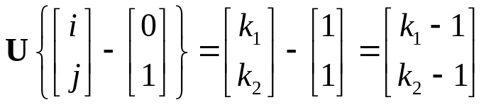
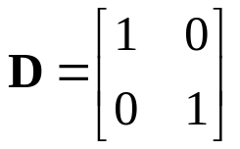
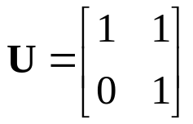
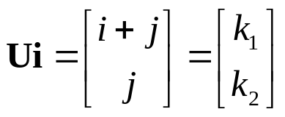
An Example
for i = 0,3
for j = 0,3
A(i,j)=A(i,j-1)+A(i-1,j)
end
end
Dependence matrix:
Applying uni-modular matrix:
Index vector transform:
Indices of variable A(i-1,j):
Indices of variable A(i,j-1):
Transformed new formulation:
for k₁ = 0,6
for k₂ = max{0,k₁-3},min{3,k₁}
A(k₁,k₂)=A(k₁-1,k₂)+A(k₁-1,k₂-1)
end
end

Slide 20
DGs of Uni-modular transform
k₂
j
i
k₁
j
i+j=6
i
i+j=0

